Slide 1
Microsoft Identity & Network Access EMEA Virtual Onsite Application & Developer Track

Slide 2
Migrating your apps from Azure AD Authentication (ADAL) to Microsoft Authentication (MSAL)
Kyle Marsh
Microsoft Confidential. Shared under NDA.

Slide 3



Speaker Bio
Kyle Marsh
Product Manager, Microsoft
IDNA CxP App Dev
https://aka.ms/bookwithkyle
@kylemar

Slide 4
Inclusive Session Guidelines
Please practice these tips while in the Virtual Onsite sessions.
Voice Guidance
Raise virtual hand so the moderator can call on you
State your name when speaking
Return to mute when not talking
Chat Guidance
Q: to preface questions
@mention to respond to an individual
Stay on topic
Use alt-text for images and gifs
Allyship
Seek to understand, not drive agreement
Focus on ideas, not people
Support and amplify peers
Avoid acronyms
Microsoft Confidential. Shared under NDA.

Slide 5
Why migrate ?
Continuous Access Evaluation
Proactive token refresh
Auth broker support
Device based Conditional Access policy – “Require managed device”
Proof of possession tokens
Experimental updates appearing – JS, .NET
Azure AD Certificate-based Authentication (CBA) on Mobile
System browsers on mobile devices
Bottom line: Features and improvements are continuous across MSAL libraries.

Slide 6
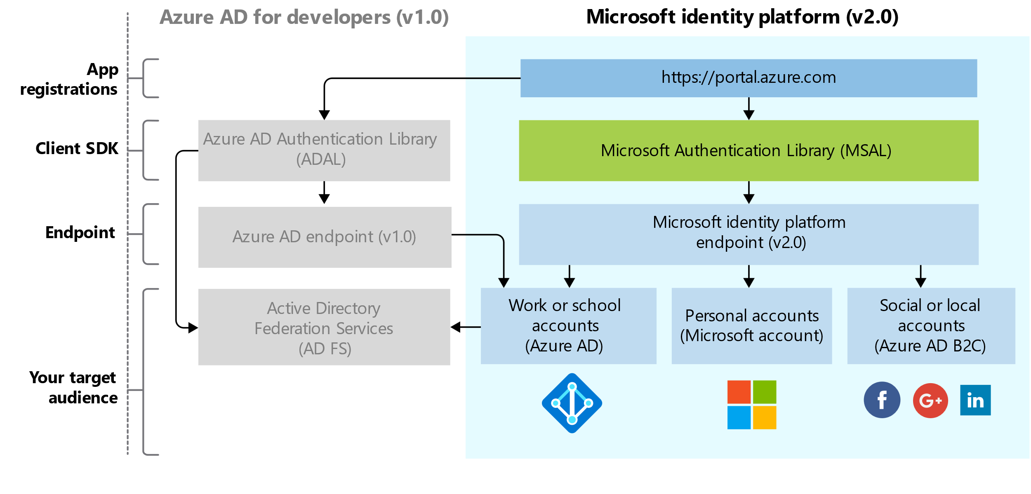
It started with a fundamental update of the platform

Slide 7
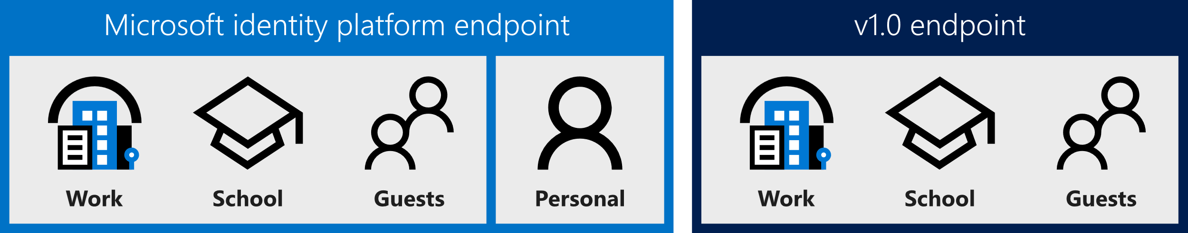
Who can sign in?

Slide 8
Consent user experience
ADAL is a static consent only experience
All “resources” have to be declared in the registration
All permissions are requested on first user and granted or denied as a group
MSAL is standards compliant and enables dynamic and incremental consent
Technically, no permissions are required in the registration, but highly recommended.
Makes it possible to have components of an app that can have separate consent.
For Line of Business apps, we do recommend admin consent.
Hence the recommendation for permissions in the app registration
Sophisticated component architecture still benefits from dynamic and incremental consent

Slide 9
Resources vs Scopes
ADAL apps ask for a token with the resource ID and the token is issued with the scopes in the app registration
https://login.microsoftonline.com/common/oauth2/authorize?
client_id=2d4d11a2-f814-46a7-890a-274a72a7309e
&resource=https://graph.microsoft.com/
MSAL apps request tokens with specific scopes
https://login.microsoftonline.com/common/oauth2/v2.0/authorize?
client_id=2d4d11a2-f814-46a7-890a-274a72a7309e
&scope=https://graph.microsoft.com/directory.read%20https://graph.microsoft.com/directory.write
More compliant with OAuth2 spec and common industry practices

Slide 10
AuthenticationContext vs Client Applications
ADAL has an AuthenticationContext class
Handles all types of applications
MSAL has a collection of client applications
Public client application are used for apps on devices, desktop computers, web browsers. Can keep secrets.
Confidential client applications run on servers. They are considered difficult to access and can keep secrets.

Slide 11
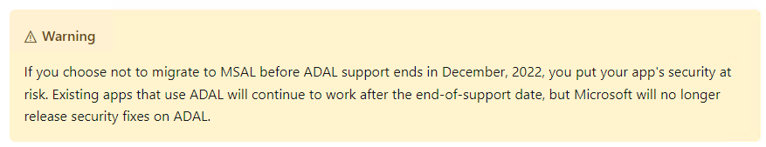
ADAL is not advancing
No new features have been added to ADAL since June 30, 2020.
There are no ADAL feature releases planned.
There are no new platform version releases planned.
Update your applications to use Microsoft Authentication Library and Microsoft Graph API - Microsoft Community Hub
Support will direct you to upgrade to MSAL as a first step.
From December 2022 this will be only option.

Slide 12
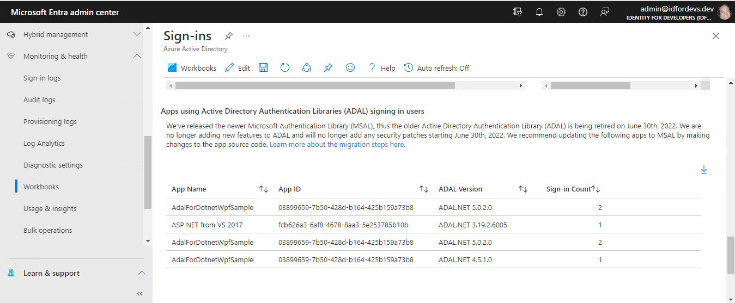
How can you find the ADAL apps in your tenant ?
Sign in workbook - good place to start

Slide 13
Each MSAL platform version has a migration guide.
Single-page app (SPA)
ADAL.js to MSAL.js
Web app
ADAL Node to MSAL Node
ADAL.NET to MSAL.NET
Web API
ADAL Java to MSAL Java
ADAL Python to MSAL Python
ADAL.NET to MSAL.NET
Desktop app
ADAL Java to MSAL Java
ADAL Python to MSAL Python
ADAL.NET to MSAL.NET
Mobile app
ADAL.Android to MSAL.Android
ADAL.iOS to MSAL.iOS
Xamarin Android using brokers to MSAL.NET
Xamarin iOS using brokers to MSAL.NET
Service / daemon app
ADAL Python to MSAL Python
ADAL.NET to MSAL.NET
ADAL Node to MSAL Node
ADAL Java to MSAL Java

Slide 14
Let's look at some MSAL.NET examples

Slide 15
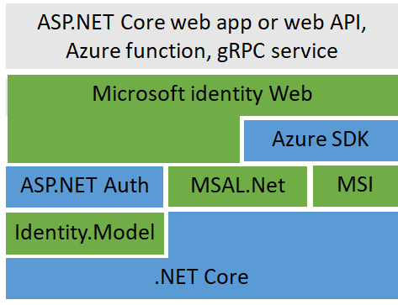
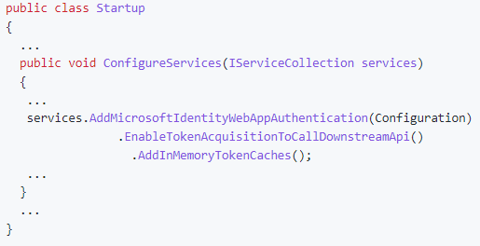
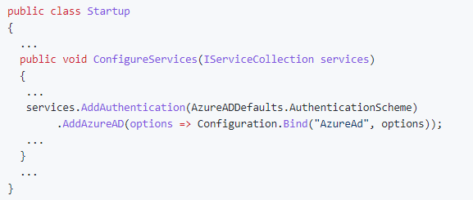
Microsoft Identity Web
A member of the MSAL “family”
The glue between many components
A higher-level library

Slide 16
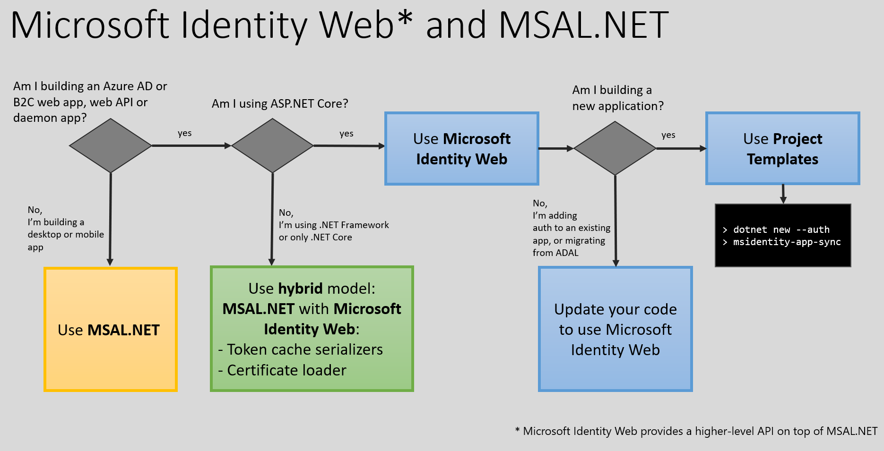
More options for ASP.NET Core WebApps and APIs

Slide 17
Migration help
Post your question on Microsoft Q&A and tag it with [azure-ad-adal-deprecation].
Open an issue in the library's GitHub repository. See the Languages and frameworks section of the MSAL overview article for links to each library's repo.
Reach out to your GTP PM, if you have one, for additional assistance

Slide 18
Questions?

